Slide 1


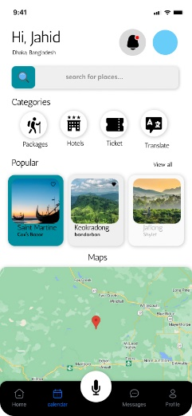
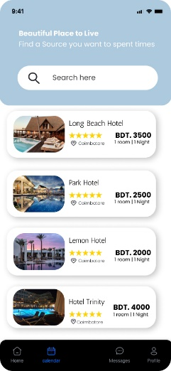
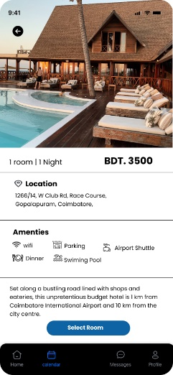
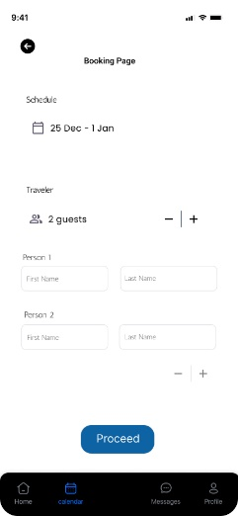
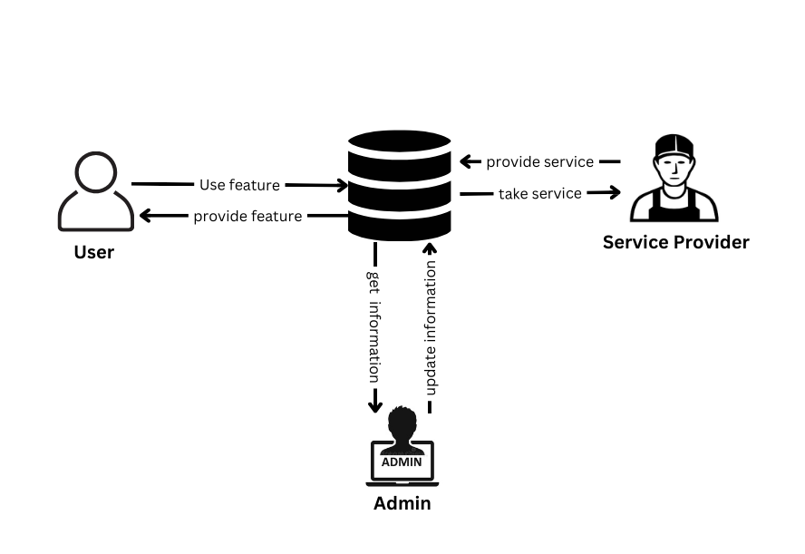
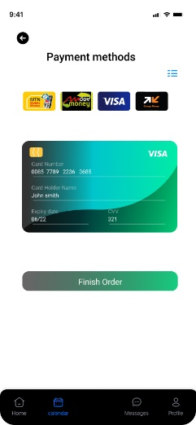
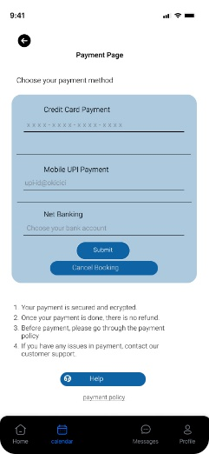

Tour Makers - Group 21
Problem Statement
The problem statement for the "Tour makers" software revolves around the need for a comprehensive, user-friendly, and interactive platform that addresses the challenges of information availability, trip planning, local insights, language barriers, safety concerns, connectivity issues, and efficient tour management in the context of tourism in Bangladesh. Such as Lack of Comprehensive Information,Difficulty in Trip Planning, Language and Communication Barriers, Safety & Security Concerns, Limited Connectivity and so on.
Proposed Solution
Special Functionalities
Implementing these proposed solutions will contribute to the success of the "Tour makers" software by addressing the challenges and providing a valuable and user-friendly platform for tourists exploring Bangladesh.
Data verification process: Establish a rigorous verification process for all information before it's published on the platform.
User input options: Allow users to manually customize their itineraries while providing suggestions based on their interests.
Offline mode development: Develop a downloadable offline version of the app that includes essential information, maps, and safety guidelines.
Functional requirements
1. Users will be able to use the app on a variety of mobile devices including Windows, Android, IOS and Linux.
2. User account creation with email or social media login options.
3. Comprehensive information about tourist destinations including historical sites natural landmarks, and cultural events.
Key Challenges
Data Accuracy and Quality: Ensuring that the information about tourist destinations, attractions, accommodations, and local experiences is accurate and up-to-date.
4. Turn-by-turn navigation and route suggestions.
Local partnerships establishment: Establish partnerships with local guides, tour operators, and businesses to provide accurate and authentic insights.
Language selection and translation : Implement a language selection feature and provide accurate translations for key content.
Data sources for real-time information: Provide emergency contact information and guidelines for various scenarios.
5. Ability to add, remove, and rearrange activities in the itinerary.
6. User ratings and reviews for local recommendations.
User-Friendly Interface: Balancing the need for comprehensive information with a clean and uncluttered design.
7. Language translation tools and a phrasebook for effective communication.
8. Integration with local emergency services.
Local Engagement and Collaboration: Encouraging locals to actively contribute and engage with the platform to keep information current and relevant.
9. User-generated reviews, photos, and travel stories.
Language and Localization: Ensuring that translations are accurate and culturally sensitive.
Unique Features
10. Recommendations for eco-friendly activities and accommodations.
Non-Functional Requirements
Reliability, Performance, Maintainability, Efficiency, Security, Scalability
Offline Accessibility: Developing solutions to provide essential information and functionalities even when tourists are in areas with limited internet connectivity.
1. Project Showcase: The app allows project creators to present their ideas, ventures, or charitable causes with compelling descriptions, images, and videos to attract potential backers.
Software Pictures
Real-Time Information and Safety: Ensuring that information about events, closures, and other time-sensitive details is current.
2. Easy Contribution: Backers can securely and conveniently contribute funds to projects of their choice through a seamless and user- friendly tour guide system.
Rich Picture
Live Local Chat: Enable real-time chat or video calls with local guides for on-demand assistance and information.
Customizable Audio Tours: Offer downloadable audio guides that users can customize based on their interests and pace.
Interactive 360-Degree Maps: Include a comprehensive calendar of local festivals, events, and cultural celebrations.
Local Language Phrasebook: Offer a built-in phrasebook with essential phrases in the local language, helping tourists communicate with locals.
Figure 1. Rich Picture of Tour Makers
Sumaiya Jannat (ID: 1730469), Kaushik Dey Joy (ID: 1821818), Jahid Hasan Milon (ID: 1930666), Abir Hossain Sangram (ID: 2022734)
Department of Computer Science and Engineering, Independent University, Bangladesh (IUB)

